Slide 1


eGovernment Team
CITY OF PORTLAND
PRESENTED BY

Slide 2
Rick Nixon
eGovernment Team
CITY OF PORTLAND
Oscar Godson
@oscargodson
Eric Arenson @ericarenson

Slide 3
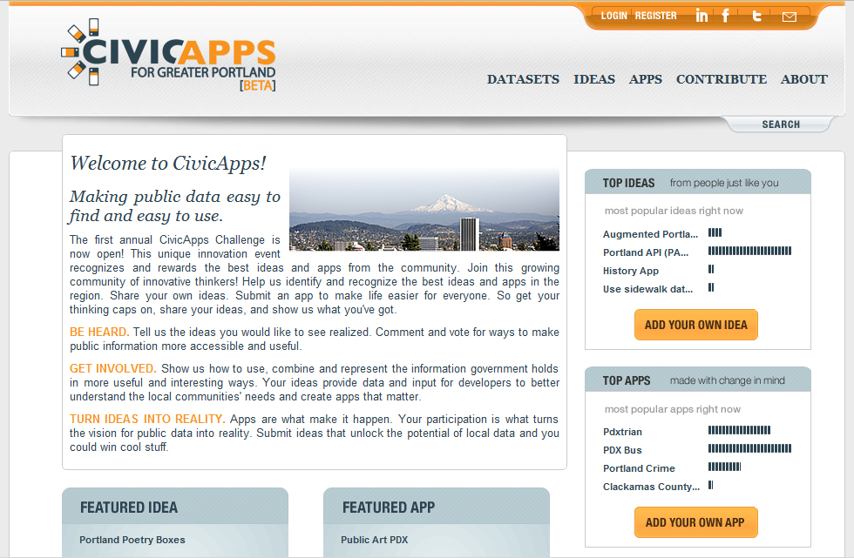

Slide 4

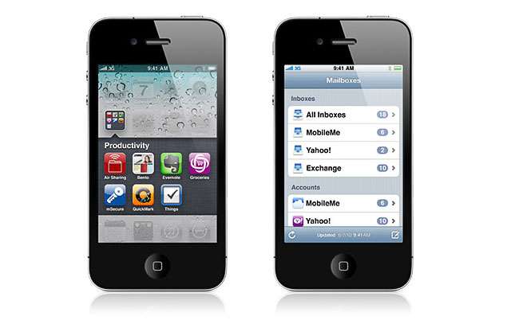
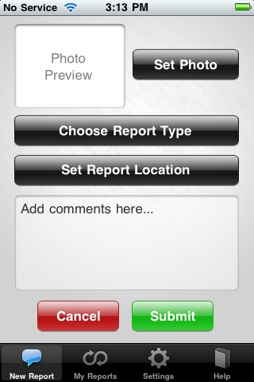
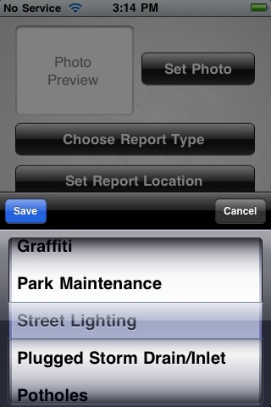
PDX Reporter
FOR iPHONE & ANDROID

Slide 5

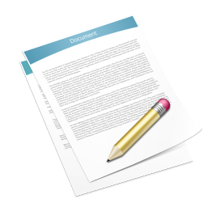

City Council Agenda Data
The old method...
CLERK
WORD DOCS
PDFS

Slide 6
• Front-end management tool
• Easy RESTful API access

Slide 7

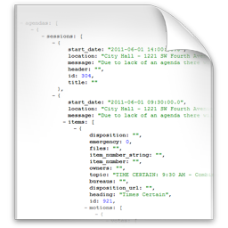

City Council Agenda Data
...the new method.
CLERK
DB
JSON

Slide 8
Front-End Application Demo

Slide 9
: Data Structure
Agendas, Sessions & Items

Slide 10
: Data Structure
What's in an Agenda?
id: 275
status: 2
Footer: "Footer text"
title: "Portland City Council Agenda"
sessions: [ … ]

Slide 11
: Data Structure
What's in a Session?
id: 282
header: "THOSE PRESENT WERE..."
start_date: "2011-05-25 09:30:00.0"
location: "City Hall - 1221 SW Fourth Avenue"
message: "Due to lack of an agenda there will
be no meeting."
items: [ … ]

Slide 12
: Data Structure
What's in an Item?
id: 875
heading: "Times Certain"
disposition: "Ordinance 2912"
Files: "attachment.pdf"
topic: "Portland Rose Festival Foundation..."
bureaus: "Office of Neighborhood Involvement"
motions: [ … ] (Contains the Council votes)

Slide 13
: API Overview
BASE URL:
http://api.portlandoregon.gov/councilagenda/
GETTING SESSIONS:
agenda/[id]/sessions
session/[id]
GETTING AGENDAS:
agendas
agenda/[id]
GETTING ITEMS:
session/[id]/items
item/[id]

Slide 14
Sample Application Demo

Slide 15
Brainstorm Session

Slide 16
GITHUB REPO https://github.com/eGovPDX
Front-end Application
API Documentation
Sample Application
Resources

Slide 17








Tomorrow, 8am-8pm
URBAN AIRSHIP
334 NW 11th Avenue
Portland, OR 97209
SPONSORED BY

